Slide 1
Creative Commons

Slide 2
How does CC work?
CC is a permission to use (reproduce, distribute and publicly perform) copyright material – literary, dramatic, musical, artistic works, films, sound recordings, broadcasts and published editions
On certain conditions

Slide 3
Key Terms
Mandatory - Attribution (BY)
Optional – Noncommercial (NC), No Derivatives (ND), Share Alike (SA)
ND and SA cannot be used together

Slide 4




Licences
BY
BY-NC
BY-SA
BY-ND
BY-NC-SA
BY-NC-ND

Slide 5
Licences

Slide 6
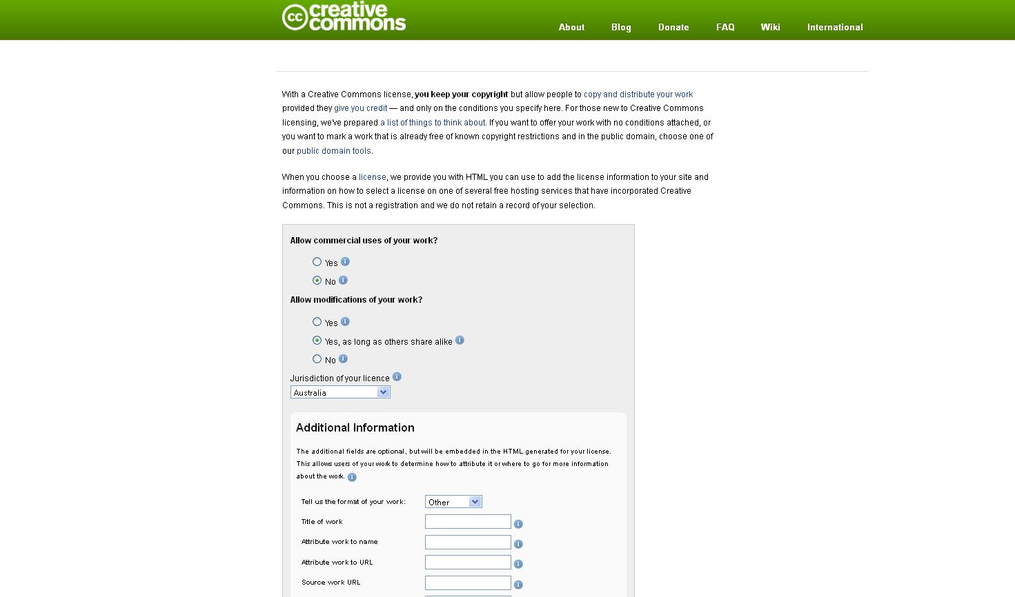

Slide 7
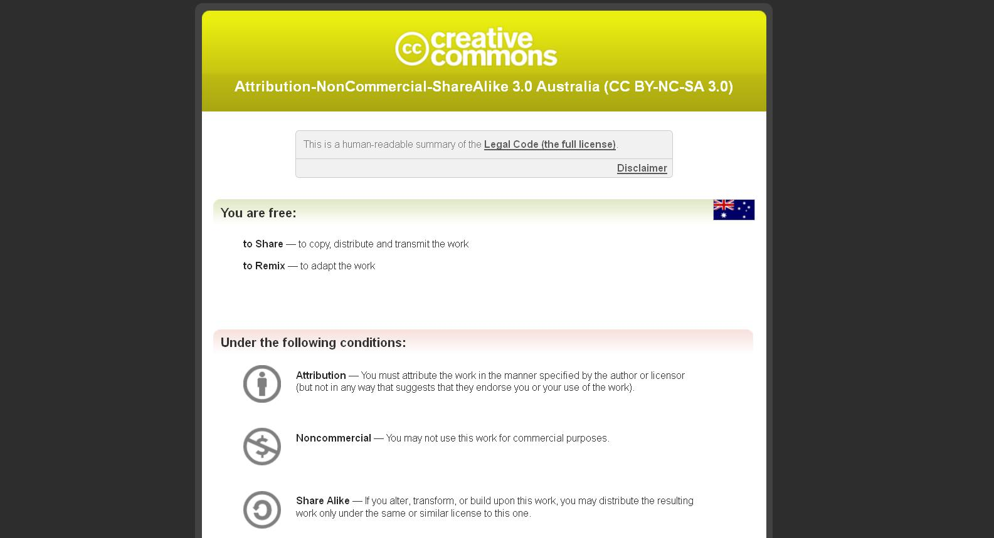
Notes:
7

Slide 8
Notes:
8

Slide 9
Notes:
9

Slide 10
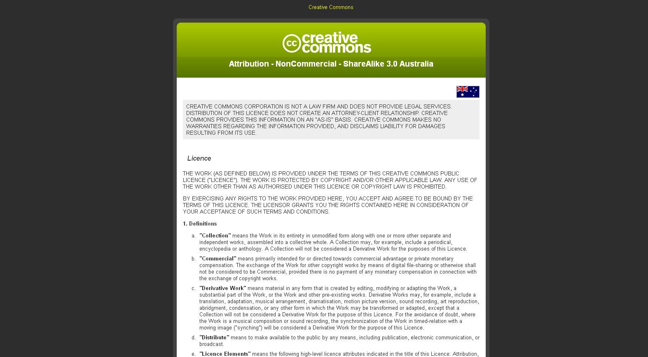
Notes:
10

Slide 11
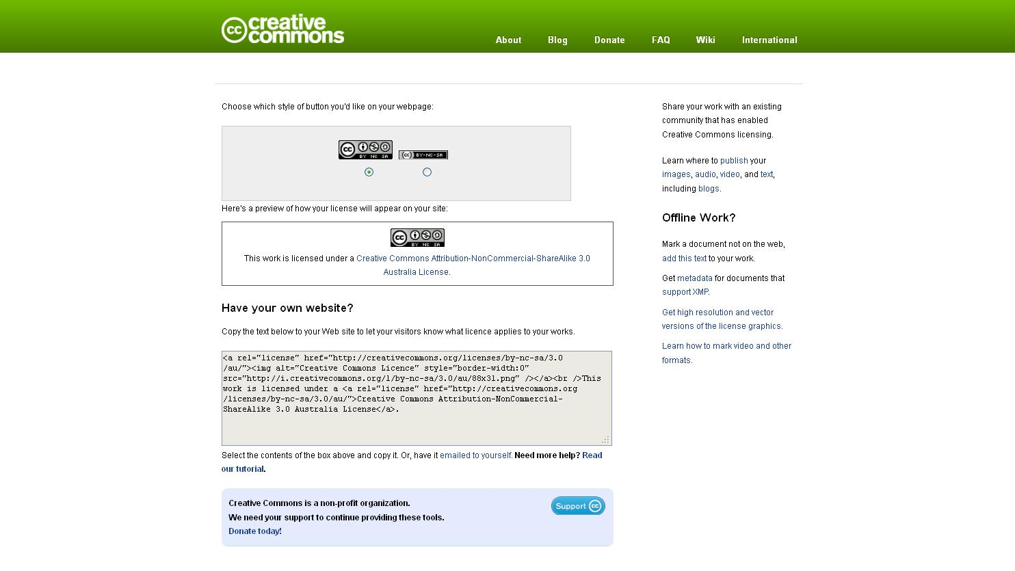
Notes:
11

Slide 12
Attribution

Slide 13
Attribution
“In a manner reasonable to the medium or means you are using”
Copyright Notice, Original Author’s Name, Other Attribution Parties, Licence (URL/hyperlink), Source and Title of Work (URL/hyperlink)

Slide 14
Attribution
Interesting examples of how this is done
eg Flickr-storm, http://www.zoo-m.com/flickr-storm

Slide 15
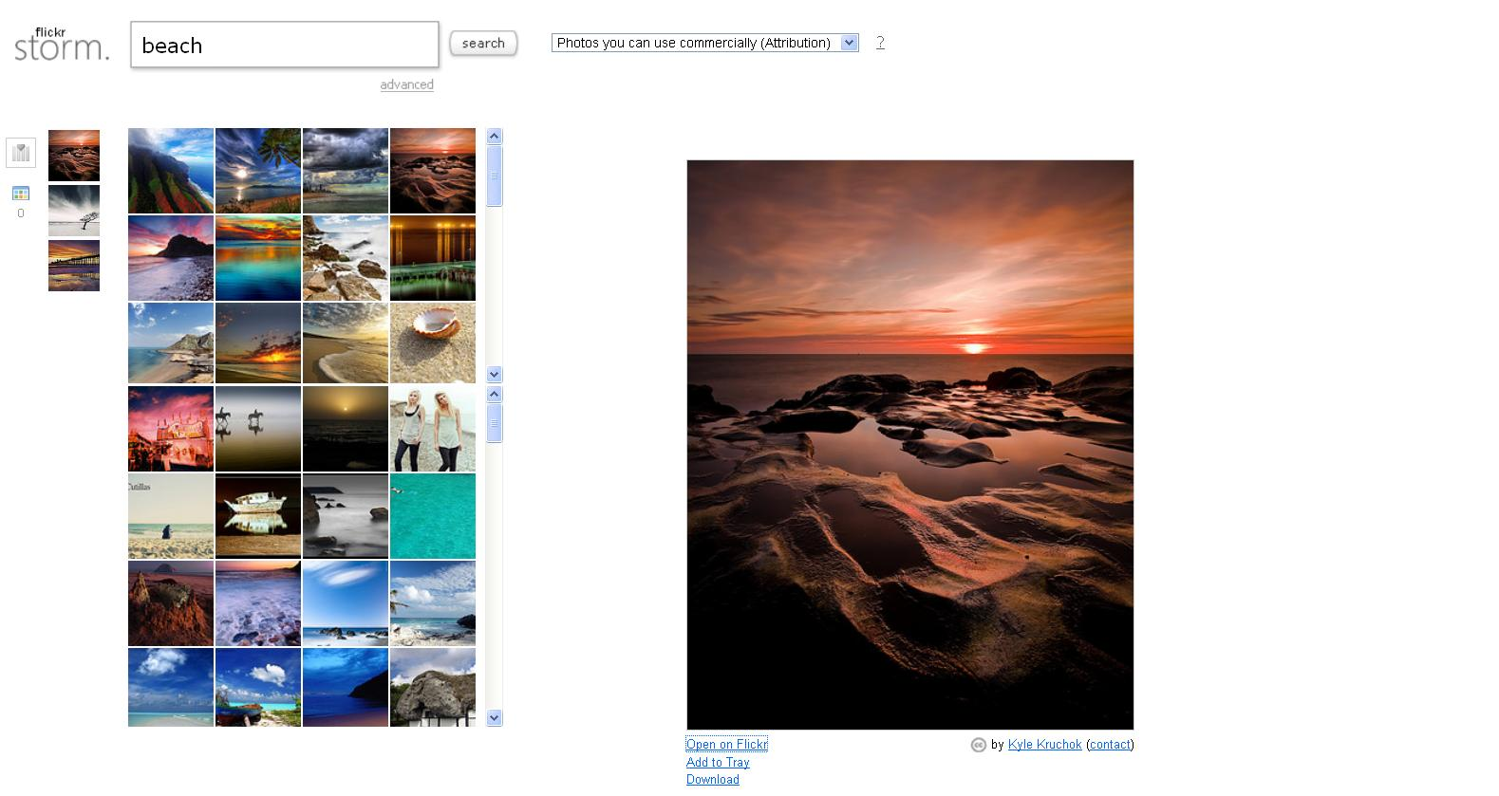

Slide 16
Noncommercial

Slide 17
Noncommercial
Clause 1 Attribution-Noncommercial-Share Alike 3.0 Australia – “Commercial” means primarily intended for or directed towards commercial advantage or private monetary compensation.

Slide 18
Noncommercial
The exchange of the Work for other copyright works by means of digital file-sharing or otherwise shall not be considered to be Commercial, provided there is no payment of any monetary compensation in connection with the exchange of copyright works.

Slide 19
Noncommercial Study
CC has released guidelines and done a recent study on the meaning of this term. There are some clear cases of what is non commercial – private and domestic use – and some clear cases of commercial use e.g. corporations using the material to gain revenue.

Slide 20
Noncommercial Study
What about an individual who runs a website and has advertisements on it to defray the costs? The CC study suggests that “… creators and users generally consider uses that earn users money or involve online advertising to be commercial ...”

Slide 21
Noncommercial Study
Defining “Noncommercial”: A Study of How the Online Population Understands “Noncommercial Use, http://wiki.creativecommons.org/Defining_Noncommercial

Slide 22
Adam Curry v Audax (2006)
Photos from Flickr published in a magazine sold commercially – Netherlands
Court said no permission and no licence to use the photos - as this was commercial use

Slide 23
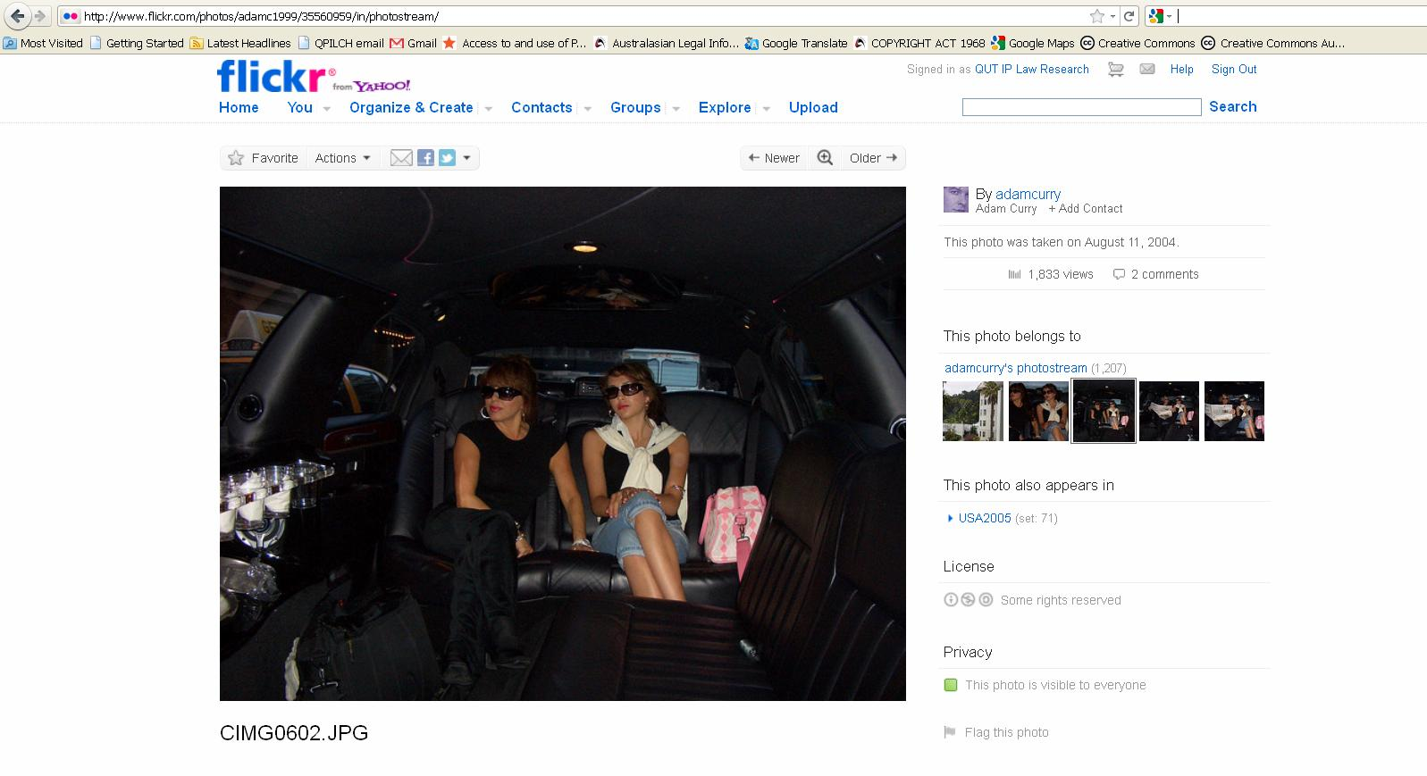
Notes:
http://www.flickr.com/photos/adamc1999/35560959/in/photostream/

Slide 24
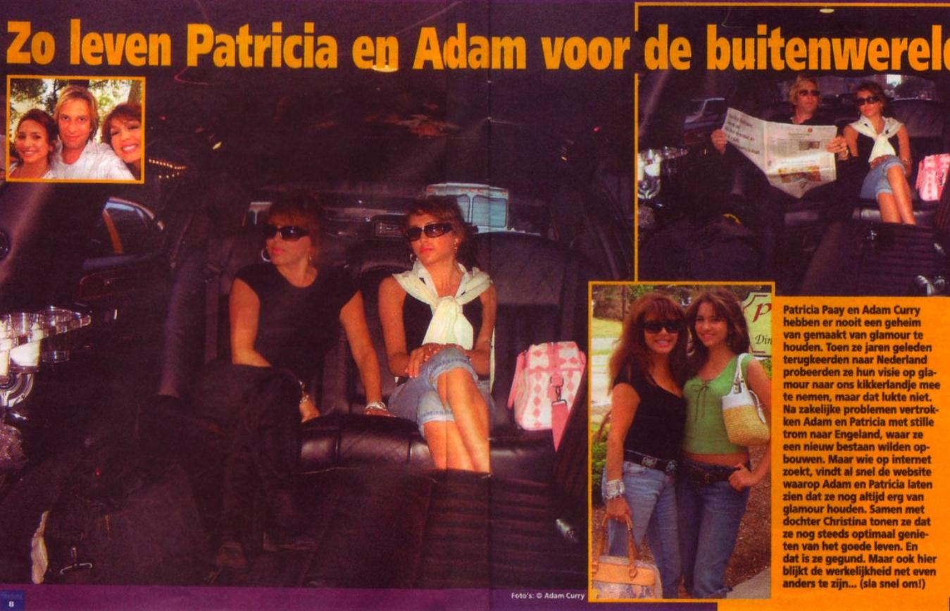
Dutch tabloid Weekend
Notes:
Dutch tabloid Weekend

Slide 25
No Derivative Works

Slide 26
No Derivative Works
Clause 1 Attribution-No Derivative Works 3.0 Australia – “Derivative Work" means material in any form that is created by editing, modifying or adapting the Work, a substantial part of the Work, or the Work and other pre-existing works.

Slide 27
No Derivative Works
Derivative Works may, for example, include a translation, adaptation, musical arrangement, dramatisation, motion picture version, sound recording, art reproduction, abridgment, condensation, or any other form in which the Work may be transformed or adapted…

Slide 28
No Derivative Works
…except that a Collection will not be considered a Derivative Work for the purpose of this Licence.

Slide 29
No Derivative Works
For the avoidance of doubt, where the Work is a musical composition or sound recording, the synchronization of the Work in timed-relation with a moving image (“synching") will be considered a Derivative Work for the purpose of this Licence.

Slide 30
Share Alike

Slide 31
Share Alike
Clause 4B(a) Attribution-Share Alike 3.0 Australia – You may only Distribute or publicly perform a Derivative Work if You apply one of the following licences to it:
i) this Licence;
ii) a later version of this Licence with the same Licence Elements (such as Attribution-ShareAlike 4.0 Australia); or

Slide 32
Share Alike
iii) a Creative Commons Unported licence or a licence from another jurisdiction (either this or a later version) that has the same Licence Elements; or
iv) a Creative Commons Compatible Licence. (* note this last option is not available in CC BY NC SA 3.0 Australia)

Slide 33
Licences – Legal Validity
Jacobsen v Katzer, 535 F.3d 1373 (Fed. Cir. 2008)

Slide 34
Who uses CC?

Slide 35


Generic 2.0 20081104_Indianpolis_IN_UAWGOTV0304 by Barack Obama, http://flickr.com/photos/barackobamadotcom/3008245391

Slide 36
Who uses CC?
Many different people
See search.creativecommons.org
Publicly funded organisations in recent times
On his first day in office in 2009 President Obama applied a CC licence to the www.whitehouse.gov website

Slide 37
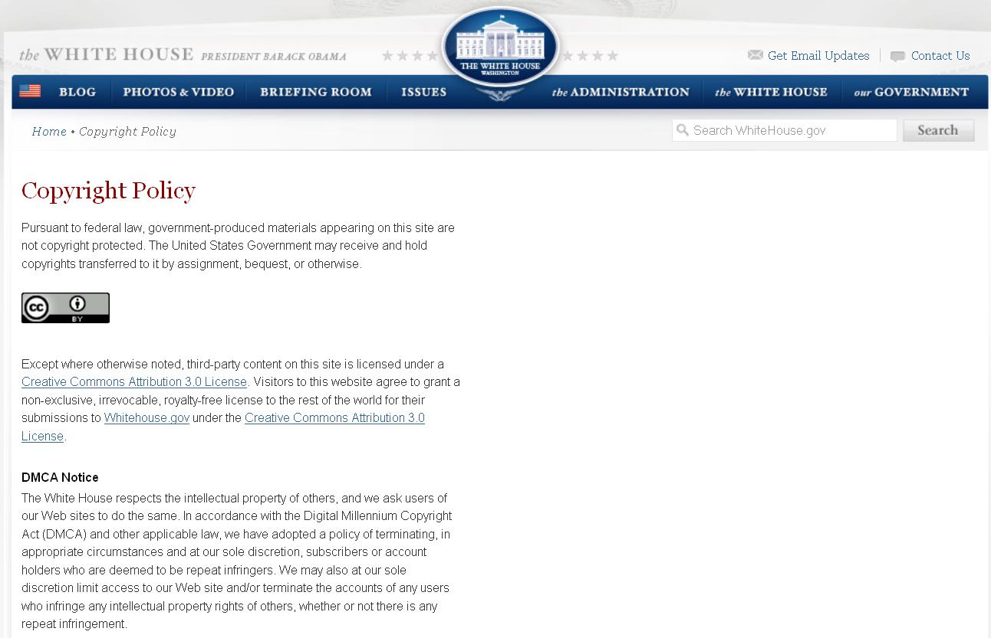
Visitors to this website agree to grant a non-exclusive, irrevocable, royalty-free license to the rest of the world for their submissions to Whitehouse.gov under the Creative Commons Attribution 3.0 License.

Slide 38


CC BY-NC-SA
Generic 2.0 Down and Out in the Magic Kingdom (cover) by Cory Doctorow, http://craphound.com/down

Slide 39

NINE INCH NAILS
Generic 2.0 Trent Reznor en vivo desde el Poliedro by Edvill, http://flickr.com/photos/edvill/3129811144

Slide 40

CC BY-NC-SA
United States 2.0 Ghosts I-Iv (cover) by Nine Inch Nails, http://ghosts.nin.com

Slide 41
9 tracks free download
36 CC-licensed tracks
5 payment options
$300 ultra-deluxe pack
2500 units only
sold out in 30 hours
$750 000
United States 2.0 Ghosts I-Iv (cover) by Nine Inch Nails, http://ghosts.nin.com

Slide 42
9 tracks free download
36 CC-licensed tracks
5 payment options
$300 ultra-deluxe pack
2500 units only
sold out in 30 hours
800 000+ transactions
United States 2.0 Ghosts I-Iv (cover) by Nine Inch Nails, http://ghosts.nin.com

Slide 43
9 tracks free download
36 CC-licensed tracks
5 payment options
$300 ultra-deluxe pack
2500 units only
sold out in 30 hours
800 000+ transactions
$1.6 million+
2 months
United States 2.0 Ghosts I-Iv (cover) by Nine Inch Nails, http://ghosts.nin.com

Slide 44

Generic 2.0 Hollywood Blvd 03.04.2007 by bossco, http://flickr.com/photos/bossco/411694842

Slide 45


Slide 46


Slide 47
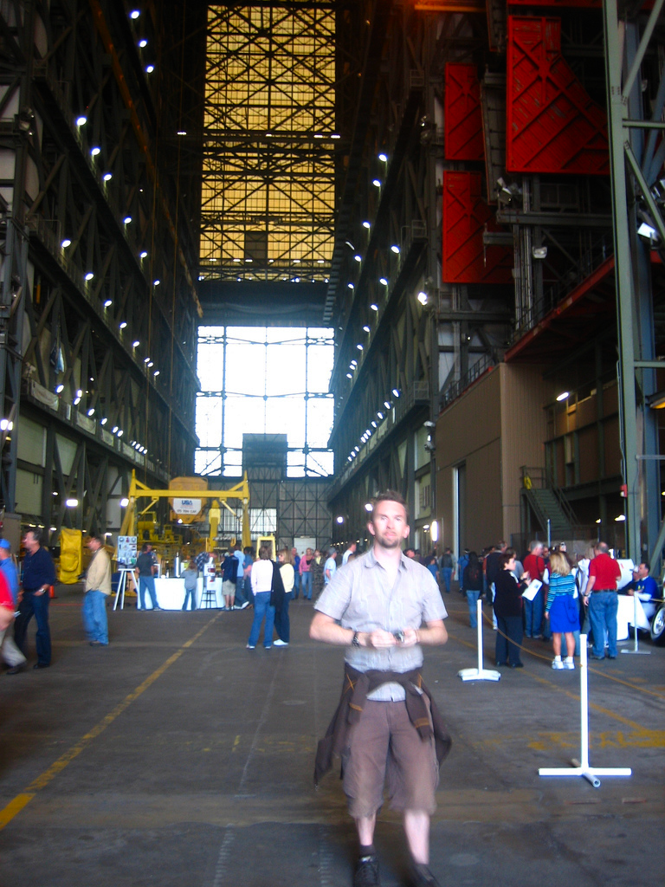
Generic 2.0 Andy in the VAB by adactio, http://flickr.com/adactio/301112397

Slide 48
JEREMY KEITH (ADACTIO)
Generic 2.0 Andy in the VAB by adactio, http://flickr.com/adactio/301112397

Slide 49
CC BY
Generic 2.0 Andy in the VAB by adactio, http://flickr.com/adactio/301112397

Slide 50
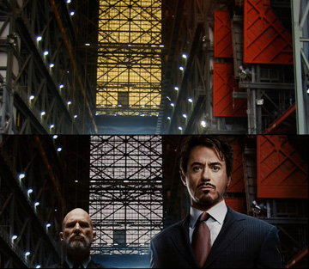
Notes:
Photo by Jeremy Keith published on Flickr. Photo of his friend at the Vehicle Assembly Building at the Kennedy Space Centre.

Slide 51
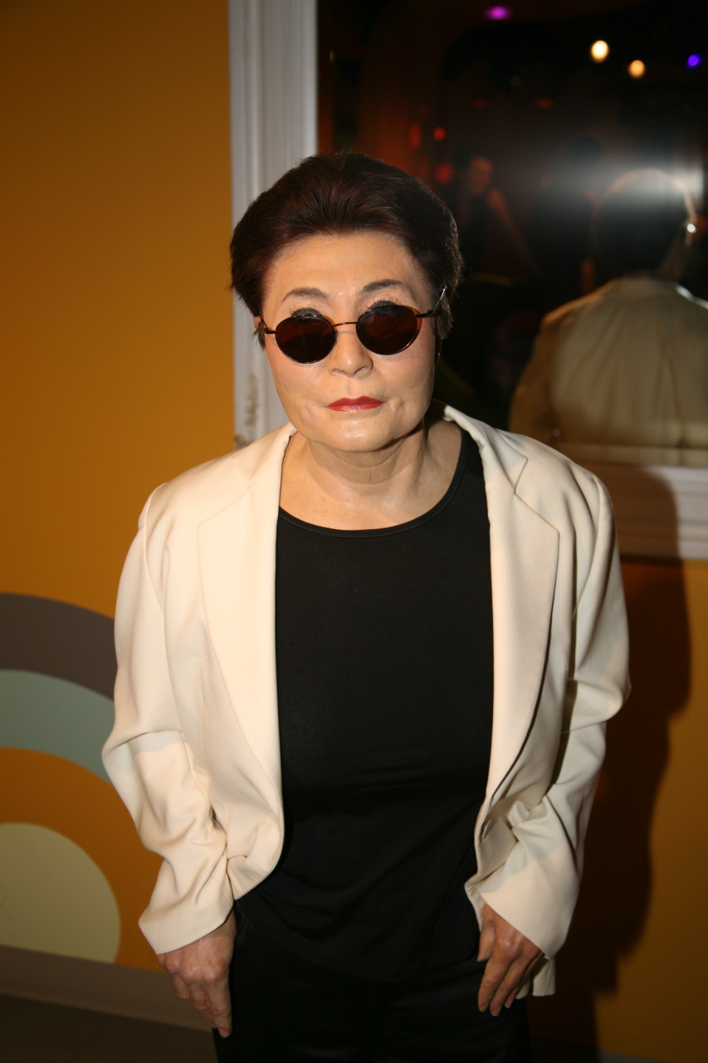
Generic 2.0 Yoko Ono by cliff1066™, http://flickr.com/photos/nostri-imago/2873284890
Notes:
reproduce the work. This includes any form of copying of the whole or part of the work including photocopies, copying it by hand, recording a dictation of it, scanning it into a digital file format or printing out a copy from a digital file.

Slide 52

Notes:
backed by Disney through Beuna Vista International

Slide 53

Venturous Australia (2008)
Recommendation 7.7
Australia should establish a National Information Strategy to optimise the flow of information in the Australian economy.
The fundamental aim of a National Information Strategy should be to:
utilise the principles of targeted transparency and the development of auditable standards to maximise the flow of information in private markets about product quality; and
maximise the flow of government generated information, research, and content for the benefit of users (including private sector resellers of information).

Slide 54
Venturous Australia (2008)
Recommendation 7.8
Australian governments should adopt international standards of open publishing as far as possible. Material released for public information by Australian governments should be released under a creative commons licence.
Recommendation 7.10
A specific strategy for ensuring the scientific knowledge produced in Australia is placed in machine searchable repositories be developed and implemented using public funding agencies and universities as drivers.

Slide 55
Gov 2.0 Taskforce Report
Engage: Getting on with Government 2.0 (22 December 2009) – http://gov2.net.au/report
Central recommendation: A declaration of open government by the Australian Government
Accompanying the Government’s announcement of its policy response to this report, a declaration of open government should be made at the highest level, stating that:
using technology to increase citizen engagement and collaboration in making policy and providing service will help achieve a more consultative, participatory and transparent government
public sector information is a national resource and that releasing as much of it on as permissive terms as possible will maximise its economic and social value to Australians and reinforce its contribution to a healthy democracy
online engagement by public servants, involving robust professional discussion as part of their duties or as private citizens, benefits their agencies, their professional development, those with whom they are engaged and the Australian public. This engagement should be enabled and encouraged.
The fulfilment of the above at all levels of government is integral to the Government’s objectives including public sector reform, innovation and using the national investment in broadband to achieve an informed, connected and democratic community.

Slide 56
Gov 2.0 Taskforce report
Recommendation 6: Make public sector information open, accessible and reusable [chapter 5, p 58]
6.1 By default Public Sector Information (PSI) should be:
free
based on open standards
easily discoverable
understandable
machine-readable
freely reusable and transformable.
6.2 PSI should be released as early as practicable and regularly updated to ensure its currency is maintained.
6.3 Consistent with the need for free and open reuse and adaptation, PSI released should be licensed under the Creative Commons BY standard as the default.

Slide 57
Gov 2.0 Taskforce report
Recommendation 6: Make public sector information open, accessible and reusable
6.6 Where ownership of the PSI data rests with the Commonwealth, data should be released under CC BY licence. Negotiation with the other party/parties will be required to ensure release under CC BY for PSI which is not owned by the Commonwealth or is shared with another party/parties….
6.7 Copyright policy should be amended so that works covered by Crown copyright are automatically licensed under a CC BY licence at the time at which Commonwealth records become available for public access under the Archives Act 1983
6.8 Any decision to withhold the release of PSI, other than where there is a legal obligation to withhold release, should only be made with the agreement of, or in conformity with policies endorsed by the proposed Office of Information Commissioner…
6.9 The Australian Government should engage other members of the Council of Australian Governments, to extend these principles into a national information policy agreed between all levels of government: federal, state, territory and local

Slide 58

Government’s response to Gov 2.0 Taskforce report
http://www.finance.gov.au/publications/govresponse20report/index.html
Generally accepted Gov 2.0 Taskforce’s recommendations (12 out of 13)
agreed in principle to Recommendation 6, including:
6.3 Consistent with the need for free and open reuse and adaptation, PSI released should be licensed under the Creative Commons BY standard as the default.
Government’s response was released under a Creative Commons Attribution (CC BY) 2.5 Australia licence

Slide 59
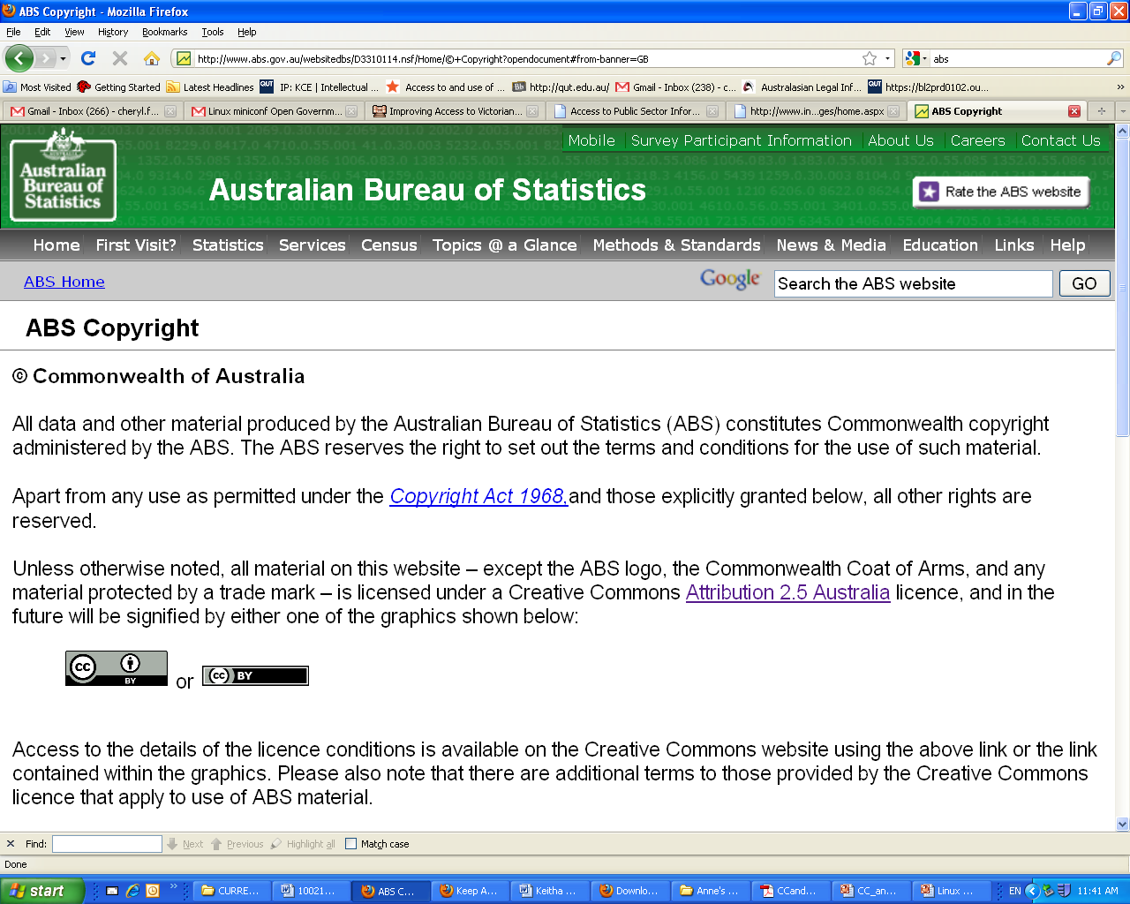
Examples of adoption in Australia

Slide 60
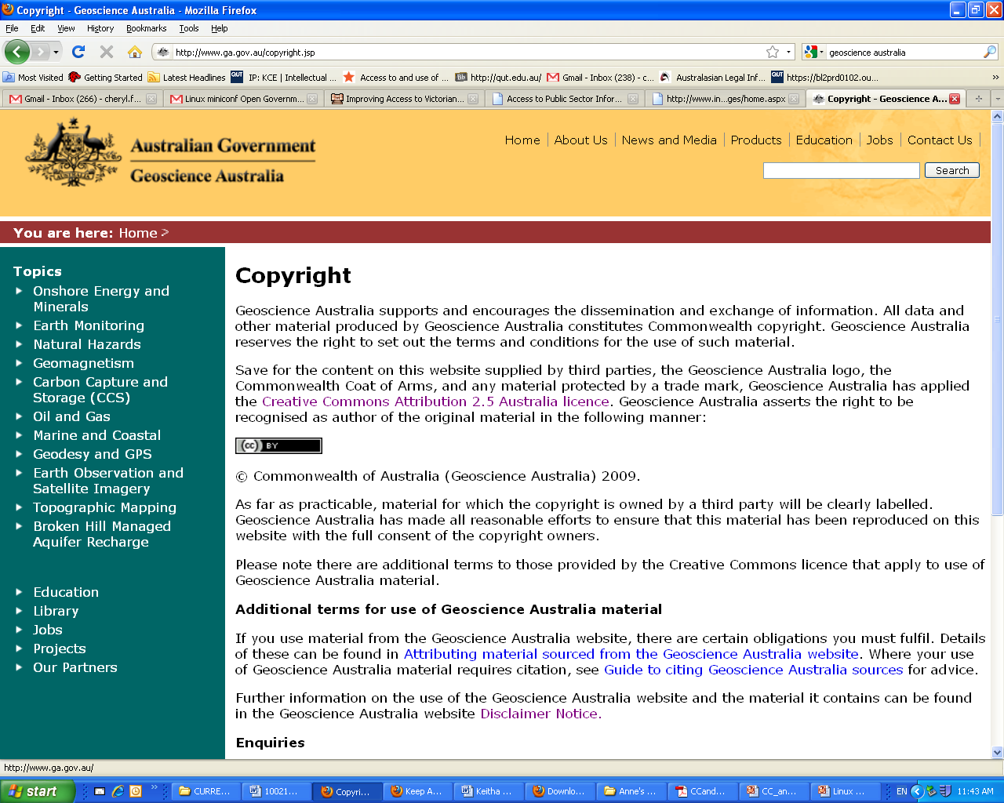
Examples of adoption in Australia

Slide 61
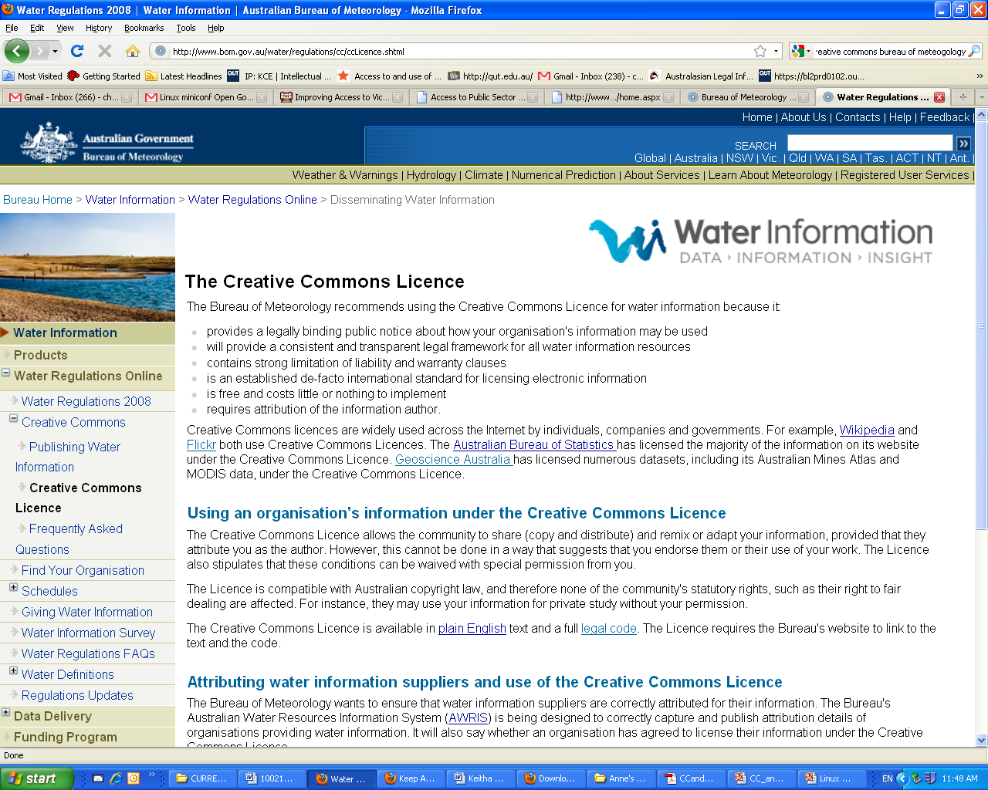
Examples of adoption in Australia

Slide 62

2010 Federal Budget Papers licensed under CC Attribution 2.5 Australia
2011 Federal Budget Papers under CC Attribution 3.0 Australia

Slide 63
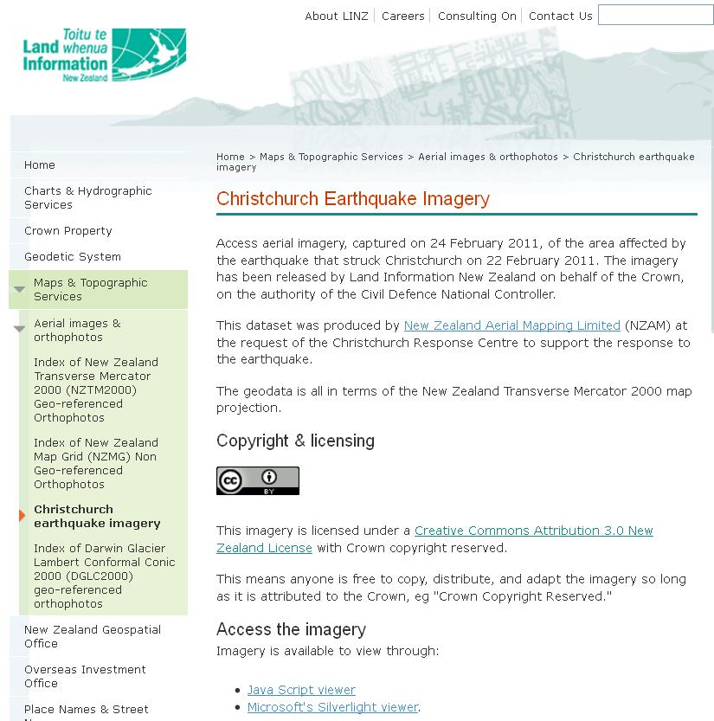
Notes:
http://www.linz.govt.nz/topography/aerial-images/christchurch-imagery/index.aspx

Slide 64
Permission for Copyright Only
Do other rights need to be cleared?
Recent issue over photos
See Chang v. Virgin Mobile USA, LLC, 2009 WL 111570 (N.D.Tex. January 16, 2009)

Slide 65
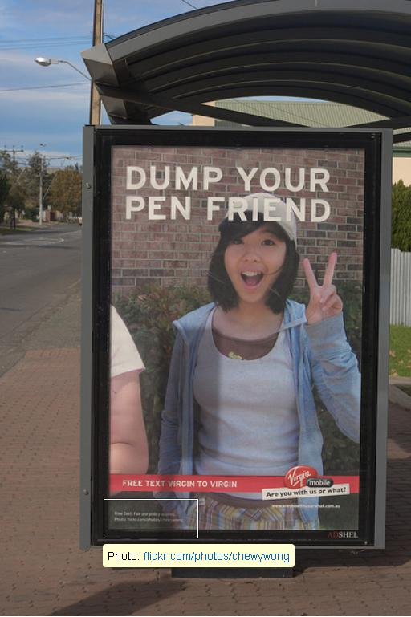
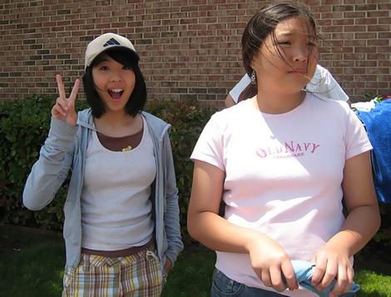
Chewywong Flickr image CC BY
Virgin Mobile billboard
Notes:
Chewywong http://www.flickr.com/photos/chewywong (image now private http://www.flickr.com/photos/chewywong/467623403/)
Dump your pen friend on Flickr http://www.flickr.com/photos/sesh00/515961023/

Slide 66
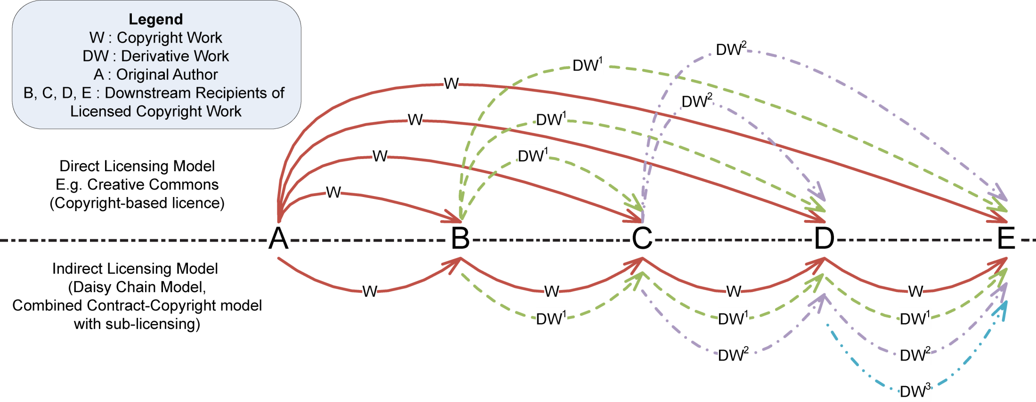
Direct, Copyright-based Licence

Slide 67
Find CC licensed materials
e.g. Images

Slide 68
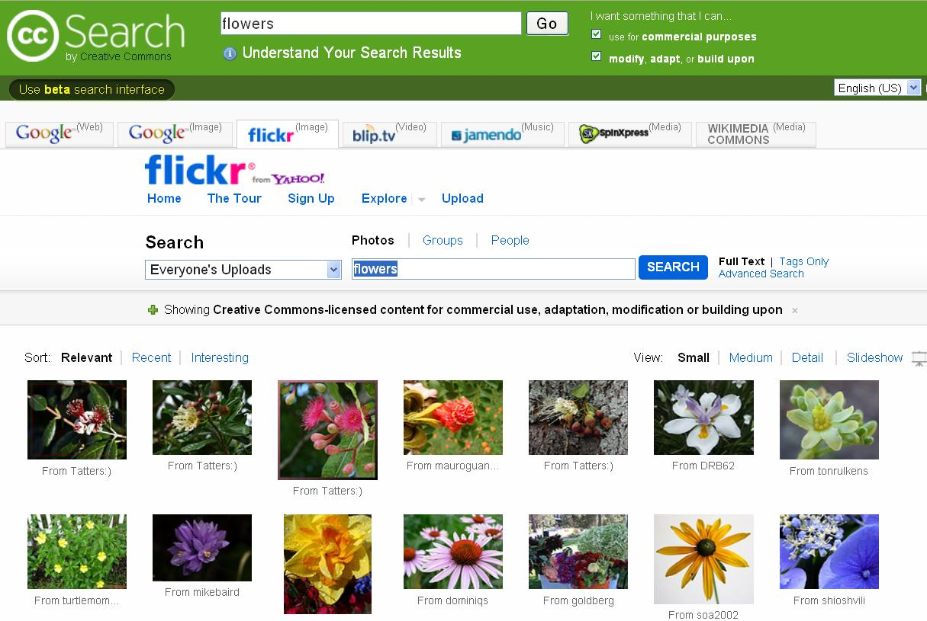
http://search.creativecommons.org/

Slide 69

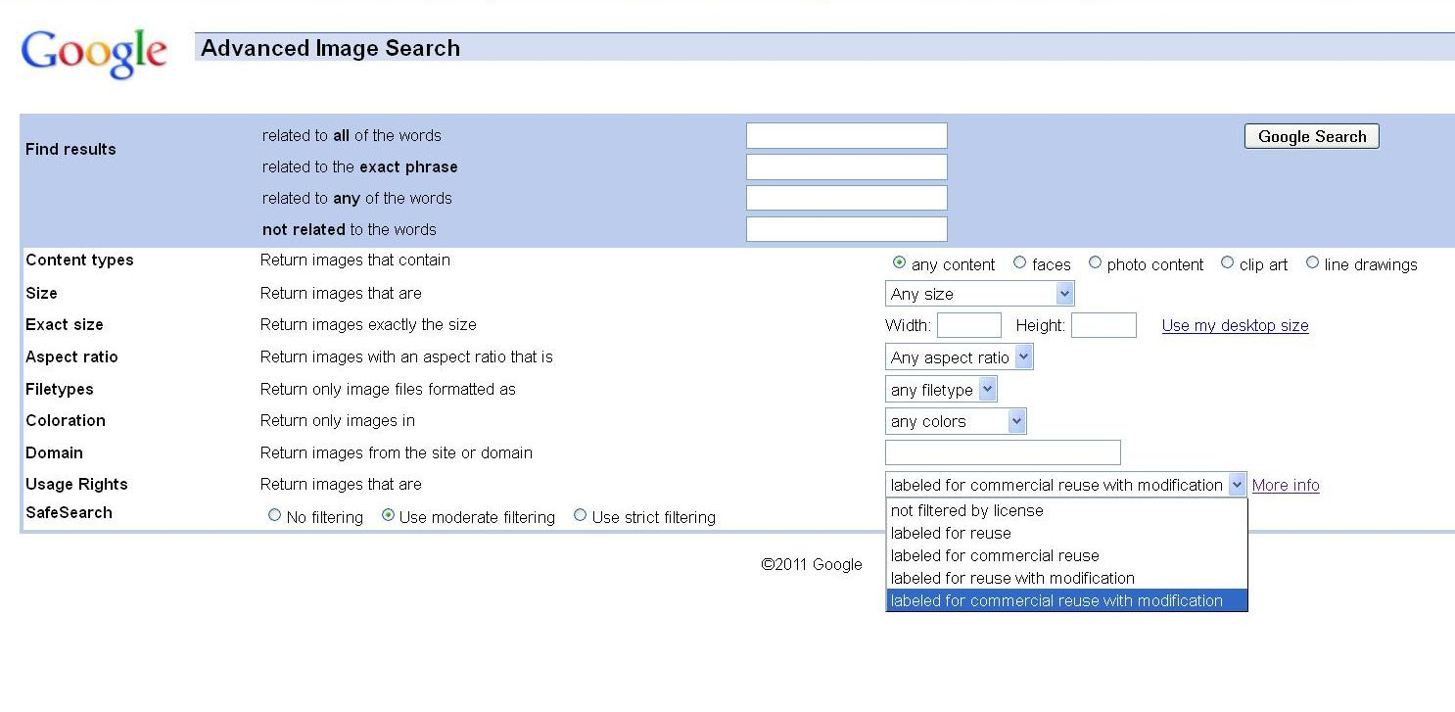

Slide 70
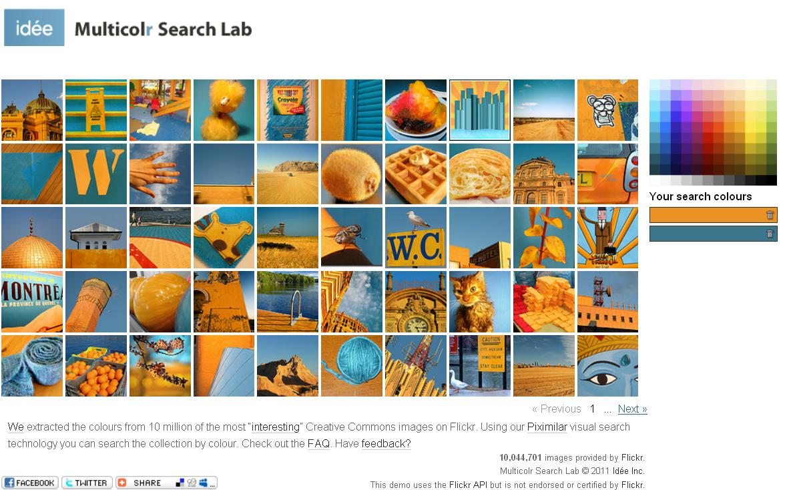
http://labs.ideeinc.com/multicolr/

